Slide 1

Across Australia
29-31 July 2016

Slide 2
What is GovHack?
GovHack is an annual hackathon competition where participants create things using open data
Teams work together over three days to explore, mash up, ideate and communicate concepts. It’s a competition and there are prizes, but GovHack is a friendly and creative environment
GovHack is for everyone! All sorts of people join GovHack, including entrepreneurs, developers, data analysts, engineers, designers, digital media creators, artists, film makers, story tellers, academics, researchers, youth and civic enthusiasts!

Slide 3
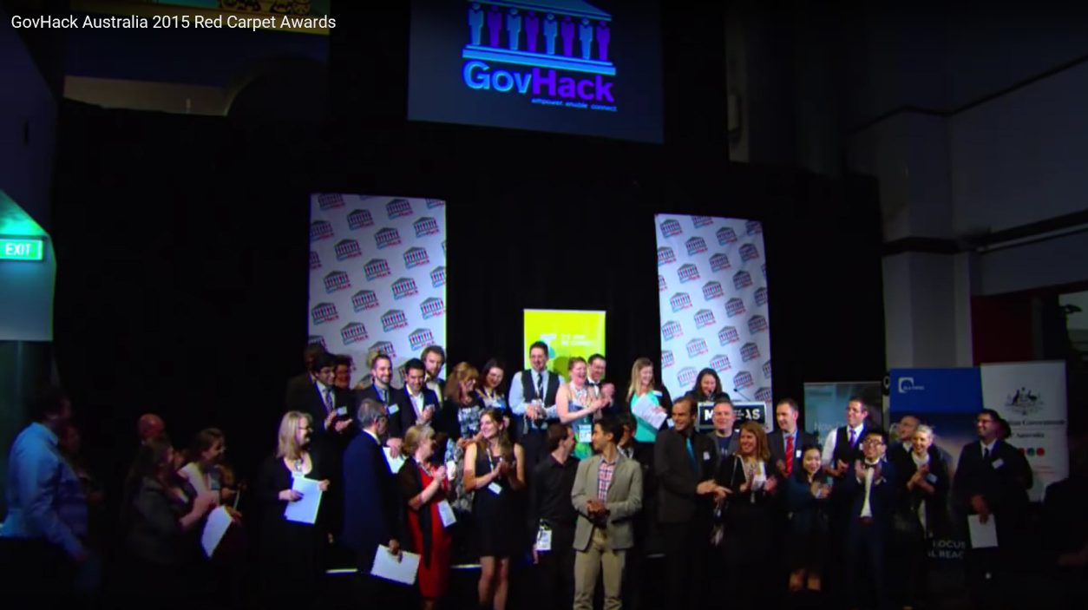
What’s the intent of GovHack?
This event provide an opportunity for Governments and Industry to support innovative communities through sponsorship and the release of new open Government data.
It creates a supportive environment for the public sector to collaborate with entrepreneurs for great outcomes.
A few lucky local representatives from GovHack finalists teams may also receive flights and accommodation to the GovHack Red Carpet Awards.

Slide 4






















Who are the GovHack 2016 Sponsors?

Slide 5
GovHack Datasets
As of 1 July, the official competition datasets have not been posted
GovHack will highlight a small number of official competition datasets from government data available from the following data portals:
data.act.gov.au - The data portal for all ACT Government data
data.gov.au - The data portal for all Australian Federal Government data
data.nsw.gov.au - The data portal for all NSW Government data
data.qld.gov.au - The data portal for all QLD Government data
data.sa.gov.au - The data portal for all SA Government data
data.vic.gov.au - The data portal for all VIC Government data
data.wa.gov.au - The data portal for all WA Government data
data.thelist.tas.gov.au - The data portal for all Tasmanian Government location data

Slide 6
What are the GovHack rules?
There are a few simple requirements for a GovHack project:
Register team and fill project information on the HackerSpace
Submit a 3 minute video by the end of the competition
Make project source code and assets available online under an open source software license
Note that we’re not supposed to work on our project until the weekend of GovHack itself, however; we can and do need to prepare

Slide 7

What is GovHack from an Avanade perspective?
An opportunity for us to…
Get to know each other a little better (How many of us have actually worked on a project together?)
Participate in a short, Agile project
Demonstrate our ability to customers and prospects
Meet people and attract new talent to the team
Gain some hands-on experience with new Microsoft tools
See multiple Microsoft Azure services in action
Challenge ourselves and have some fun!

Slide 8

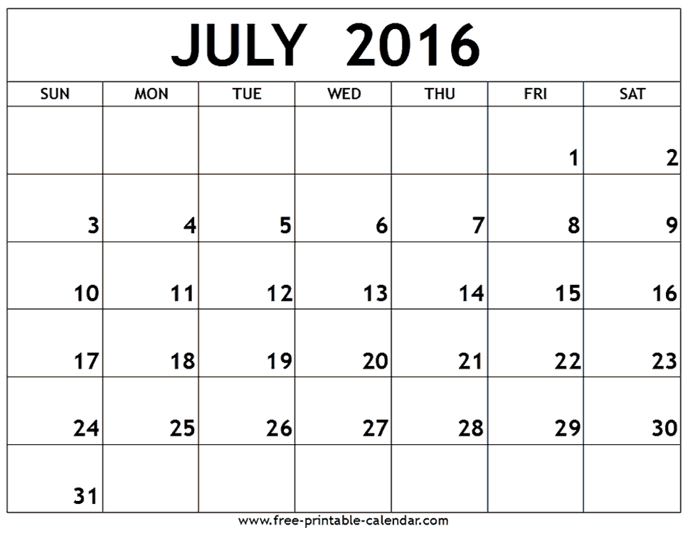
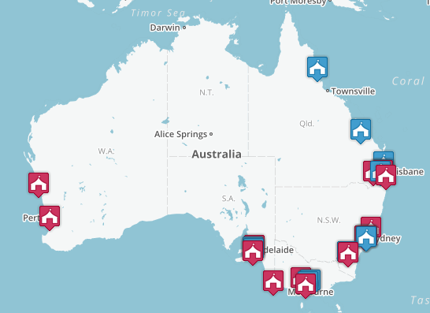
When and Where is GovHack?
Mark your calendars!

Slide 9
What are the GovHack Timelines?
29 July
7pm Friday Local time – Hackerspace opens and prize categories are announced for your region
30 July
12pm Saturday Local time – All competitors must register as a user on Hackerspace
5pm Saturday Local time – A Team Project Page and your prize category nomination must be completed in Hackerspace. Record all your team members on your project page and the URL to your proof of concept repository. No new projects pages can be created after this time. You are still able to edit your project page after this time
31 July
4pm Sunday Local time – Video finalised and a URL linking to video created
5pm Sunday local time – All parts of competition entry finalised which includes:
Team page
Data story description and detail of data sets used
Project outcomes (demo’s, code, graphics, photos submitted)
Video link uploaded

Slide 10


What do we do next?
Register
Go to https://www.govhack.org/locations/
Register for the official event in your city
Putting on your thinking cap and get creative
Go to http://portal.govhack.org/datasets.html to see potential datasets that may be used
Check site regularly for official datasets to be published
Review participation kit http://govhack-toolkit.readthedocs.io/
Create Team
Ray will register team once we’ve shaped our ideas
Join our team before 29 June
Create Node Events
We will determine if Avanade offices will used to host “Node Events” depending on level of participation in each city

Slide 11
What’s your commitment to the team?
Participate weekly planning sessions (brainstorming, storyboarding, ideation)
Study up & prototype on your area of technology
Attend GovHack event on 29, 30 and 31 July; a portion of all of it is okay

Slide 12
GovHack Judging Criteria (in no particular order)
Consistency with contest purposes including social value
Quality and design (including standards compliance)
Usability (including documentation and ease of use)
The relevance to the team nominated category definition
Specific prize eligibility criteria detailed (if any) e.g. data use, team criteria
Originality

Slide 13
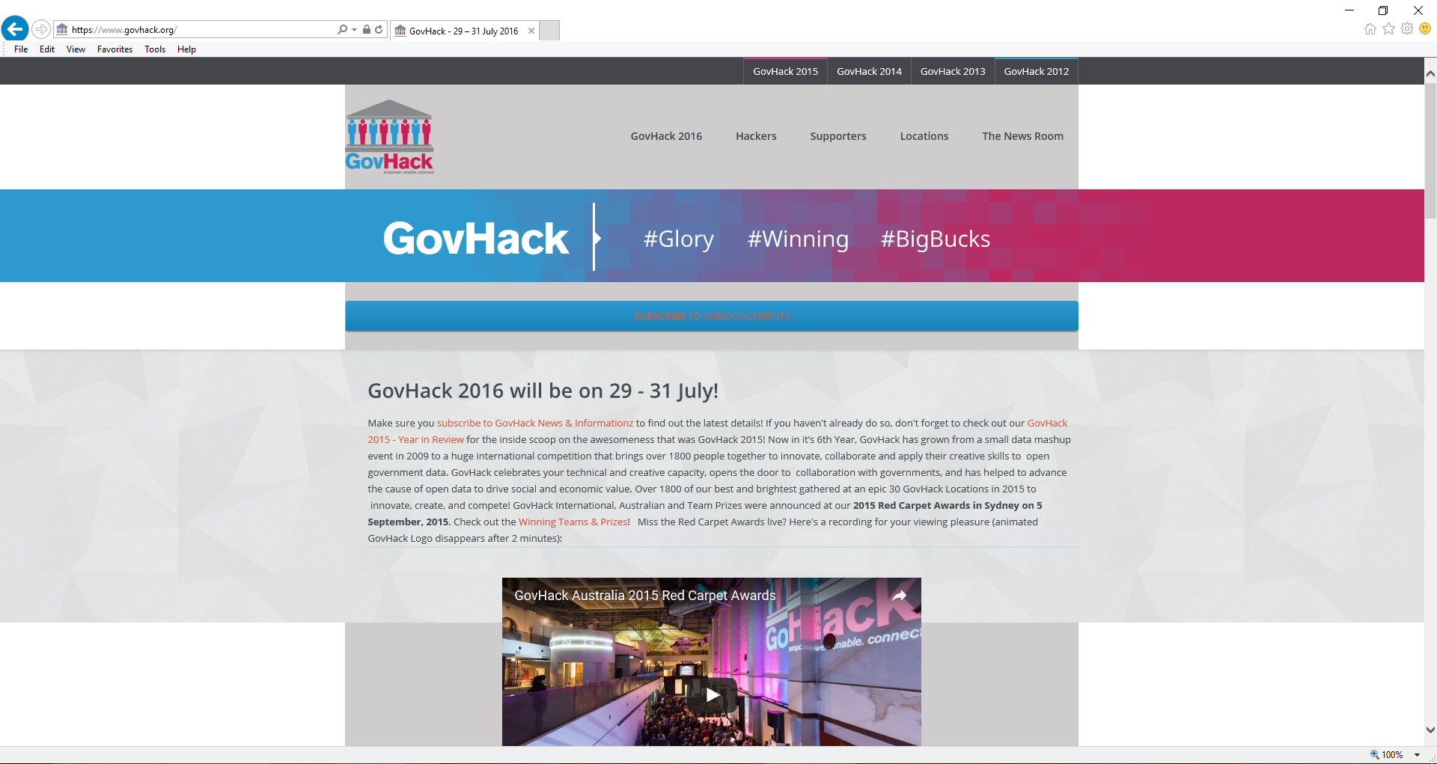
GovHack 2016 http://www.govhack.org

Slide 14
21 July 2016
Update

Slide 15
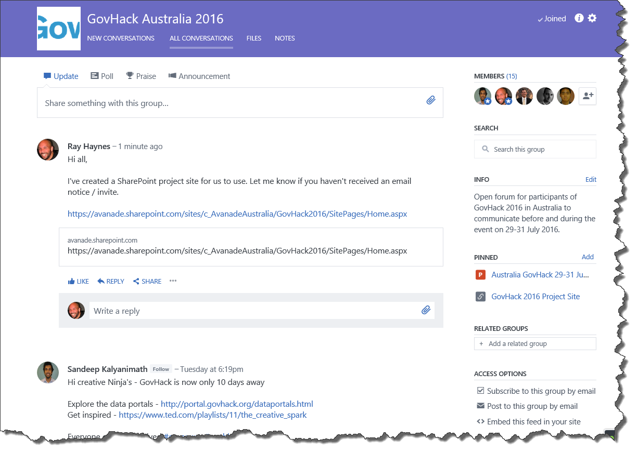
GovHack 2016 – Yammer Group

Slide 16
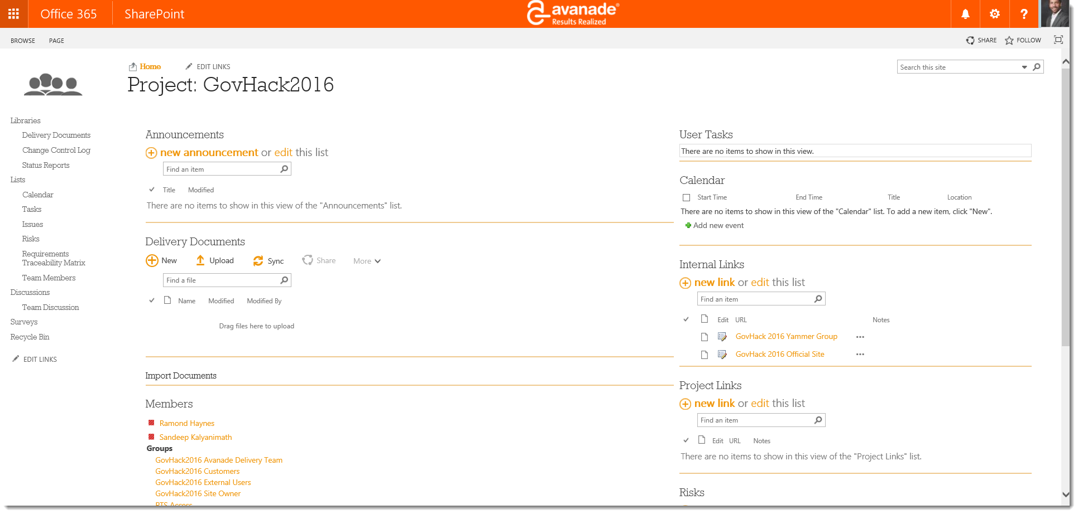
GovHack 2016 – SharePoint Team Site

Slide 17
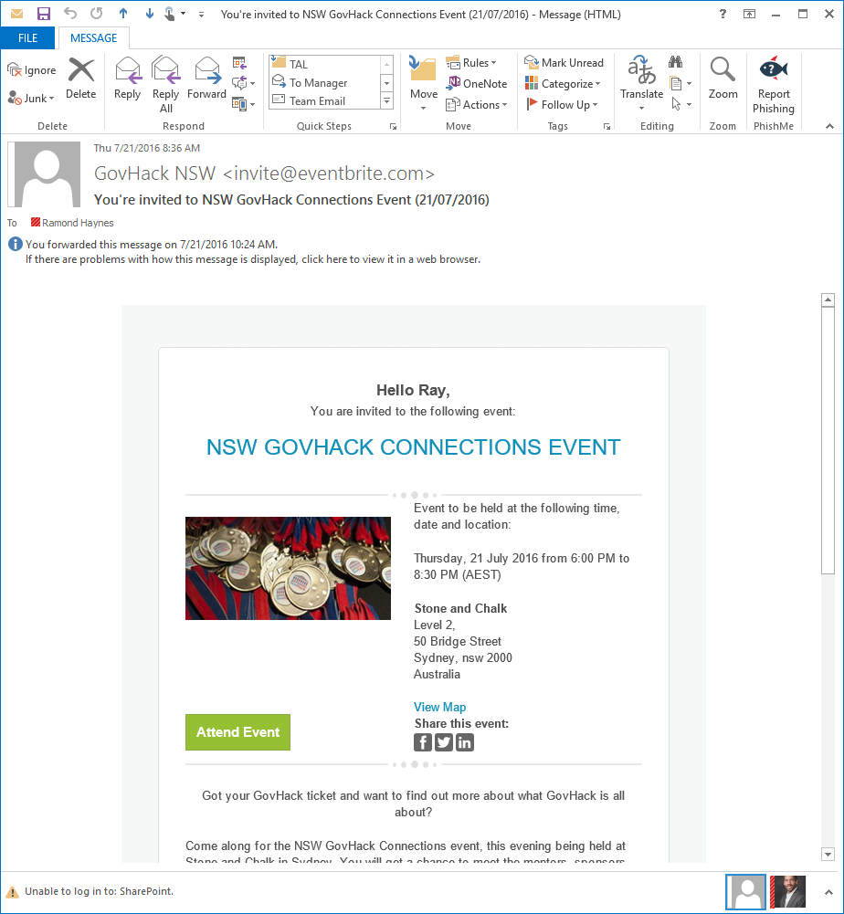
GovHack 2016 – Local Events
The rumor is the theme will be Transportation

Slide 18













GovHack 2016 - AMAP Environment (Draft)
Data Ingestion
Data in Motion
Data Storage & Modelling
Compute + Analytics
Data Consumption
Data Feeds & Sources
Real-Time Transactions & Events
Metadata Repository
Data Stewardship
Stream
Real-time Data
Data Catalog Service
Data Service APIs
Data Catalog Service
NSW Data Source
Azure IOT Hubs
Azure Stream Analytics
Azure Event Hubs
Azure IOT
Suite
App Insights
App Service
VIC Data Source
Self-Service Analytics
Azure Data Factory Service
API Web Apps
Logic Apps
Azure Search
Batch
Transform
Azure DB
QLD Data Source
Data
Warehouse
Power BI Service
Azure File Storage
Azure
Blob Storage
Azure Data Factory Service
Batch Transactions
Azure
Blob Storage
Build/Train Models
SA Data Source
Data
Lake
Azure ML Studio
WA Data Source
HDInsight
(R Server, Hadoop, Hive…)
ACT Data Source
Data Mashup & Compute
R Studio
Installed but not used
for GovHack

Slide 19
GovHack 2016 – The Team
Team | Location | Note | Process | Technologies
Ray | NSW |  | Story, Project, Video DW, Visualisations | Pinnacle Studio Azure SQL Database, PowerBI
Mark | NSW
Paula | NSW | Remote, part-time
Adam | NSW
Sunil | NSW |  | DW, Visualisations | Azure SQL Database, PowerBI
Mark | NSW
Arun | NSW | Not available Sunday Morning | DW, Visualisations | Azure SQL Database, PowerBI
Dom | NSW | To be confirmed
Rivaaj | WA |  | Data Lake, MapReduce | HDInsight
Sandeep | VIC |  | Data Ingestion, Data Lake | Blob Storage, Azure Data Factory
Filip | VIC |  | Predictive Model | Azure Machine Learning
Edward | VIC |  | Data Ingestion, Visualisations | Azure Data Factory, PowerBI
Calvin | ACT |  | Data Lake, MapReduce | HDInsight
Luke | U.S. | Environment Set-Up
Michel | NSW | On Leave
Scott | WA | Personal Commitments

Slide 20
26 July 2016
Update

Slide 21
GovHack 2016 - AMAP Environment (Draft)
Data Ingestion
Data in Motion
Data Storage & Modelling
Compute + Analytics
Data Consumption
Data Feeds & Sources
Real-Time Transactions & Events
Metadata Repository
Data Stewardship
Stream
Real-time Data
Data
Lake
Data Catalog Service
Data Catalog Service
NSW Data Source
Machine Learning
Azure Event Hubs
Azure IOT Hubs
Azure Stream Analytics
Build/Train Models
VIC Data Source
Azure
Blob Storage (Raw)
Data for experiment and model dev
Assumes Azure ML
150 hours per month per seat
for 5 seats
Azure ML Studio
Data
Warehouse
ADF
Azure ML API
Self-Service Analytics
QLD Data Source
6 activities
ADF
Azure File Storage
Azure Data Factory Service
6 activities
Azure DB
Size S1 (250 GB)
SA Data Source
6 activities
Azure
Blob Storage (Stage)
HDInsight used for Hive Transformations
Power BI Desktop
Power BI Service
Batch Transactions
Assumptions:
Total data size per load is 100 GB of raw files
6 copy activities for 6 files from File Share to blob store
6 hive transform activities from raw to stage
6 copy activities from blob stage to ASQL DB
Data load for modelling is manual and not scheduled
Assumed Azure ML hours on the higher side 150 hrs. per month per seat for 5 seats
Assumes zero Azure ML API calls
Risks
HDInsight with R Server on Spark is in Preview
Data Catalog service needs Azure AD integration
Batch
Transform
Data for experiment and model dev
Build/Train Models
100 GB of raw files
100 GB of staged files
Retention: 1 year
WA Data Source
Premium Tier (PREVIEW)
2 Head Nodes : D4 v2
4 Worker Nodes: D4 v2
1 R Server Node D4 v2
R Tools for VS
ACT Data Source
HDInsight with R Server on Spark
(Hadoop, Hive)
Data Mashup & Compute
Install but not used
for GovHack

Slide 22
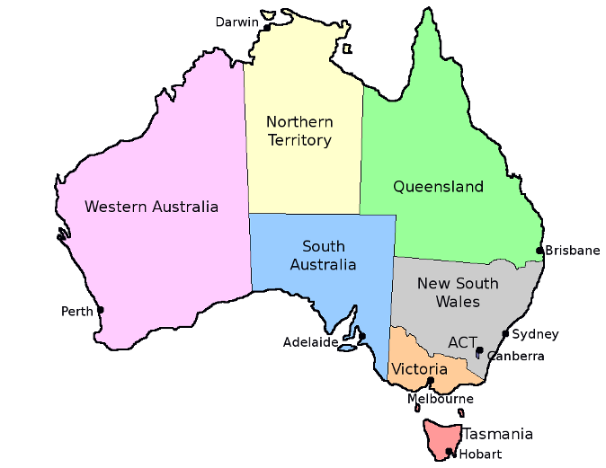
GovHack 2016 – Avanade Teams
Team 1 = Australia
Team 2 = NSW
Team 3 = VIC
Mark
Arun
Rivaaj
Sunil
Adam
Ray
Paula
Calvin
Edward
Filip
Sandeep

Slide 23
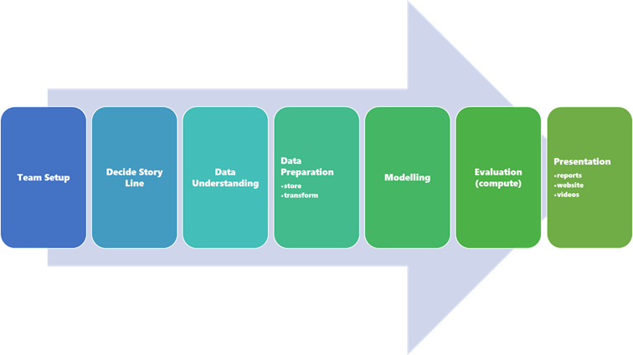
Logistics in Progress
Additional Team Members
Storyline Ideas
Schedule
Photos
Contact Info
Video

Slide 24
GovHack Mentors are available across the country
Victoria
Alica Daly, Head of Patent Analytics, IP Australia
Queensland
Andrew McDermott, Assistant Director - Data Integrity, Australian Business Register
Darren Santer, Coordinator Digital Design and Data, City of Gold Coast
Earl Butterworth, Data Governance, Department of Communities, Child Safety and Disability Services
Kelvin Ross, Director, KJR
Mitchell Stanton-Cook, Engineer, Open Knowledge Australia (BNE), XVT Solutions
Paul Morris, UXD Lead, Symplicit
Steve Jones, Director, Science Information Services, Queensland Department of Science, Information Technology and Innovation
Australian Capital Territory
Jared Cane, Business Analyst, Australian Business Register
Jenny Coppock, Business Development Officer, ATO
Shanti Reddy, Geospatial Analyst, Department of the Environment
New South Wales
Angela Bee, Founder, Hackathons Australia
Anthony Tockar, Data Scientist, CBIG Consulting
Blair Hudson, Innovation Portfolio Manager - Data Science, Pepper Group Limited
Geoffrey Huntley, Software Engineer
Tim Stokes, Technical Architect, Healthdirect Australia
Tom Park, Director, Deloitte
Western Australia
Jag Atrie, Manager, Epidemiology Branch, Western Australian Department of Health
James Gardner, An awesome developer
Ken Parker, A/Manager, Capacity Building, Department of Local Government and Communities

